Slide 1
Nick Berry
Making Money in Social Gaming
M.Eng, ARAeS, CIPP
President
All logos and trademarks in this presentation are property of their respective owners.

Slide 2

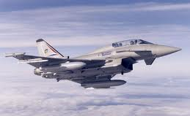


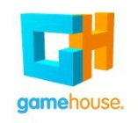
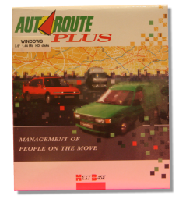
Biography – Nick Berry
1988
1994
2008
2010

Slide 3
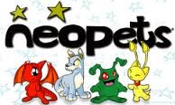











PC Casual Game Universe
Web
Download
Social

Slide 4
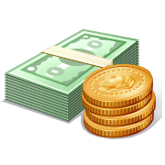
PC Casual Game Universe
Web
Download
Advertising
Sales
Micro-transactions
Social

Slide 5
Web Portals

Slide 6
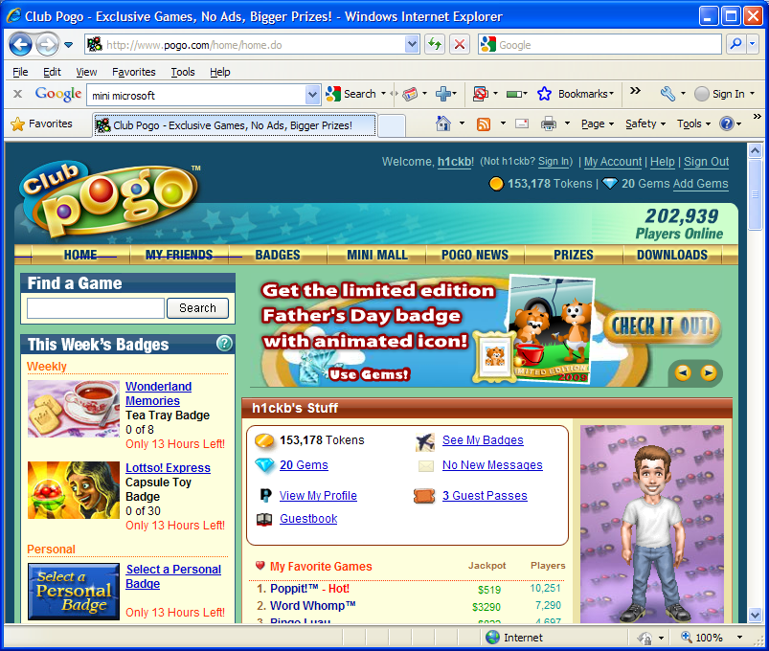
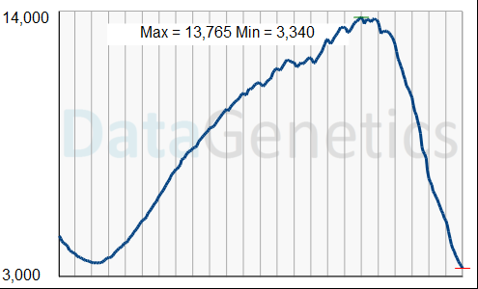
Number of players
24 hours

Slide 7
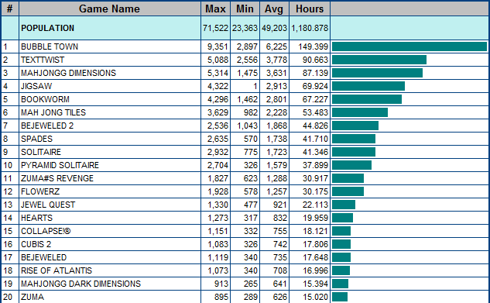
The Results
Advertising Potential

Slide 8
Download Games

Slide 9
Price evolution of deluxe downloads
$19.95
$19.99
$15.99
$12.99
$9.99
$6.95
$6.99

Slide 10
Social Networks
facebook

Slide 11
What is a Social Game?
“But they’re not social!”
“A game played on a Social Network”
(After all, “Casual Games are not casual” either!)
P
P
Not Work!
So what is a game?
“Any non-obligatory activity that is performed for fun!”

Slide 12
A Social Game is …
… any non-obligatory activity that is performed, for fun, on a Social Network

Slide 13
Why are Social Games so Popular?
Discoverability
Accessibility
A non-obligatory activity that is performed for fun.
Certainly describes many of the “Activities” on Facebook!
Players broadcast their indulgences, performances and achievements (both actively and passively).
In no more than a couple of clicks, exposed users can be having fun, and jumping on the latest bandwagon of distraction.
Facebook has exposed people to copious quantities of non-essential activities and provided easy channels to announce participation in these entertainments to others.
Whilst social could be considered a poor
adjective to describe games when many games
are solo activities, these activities do earn it the moniker social because they offer a shared experience. Albeit asynchronously, all the people who have enjoyed the same activity have been down the same path.
Curiosity, Invitation, Peer Pressure, Challenge
Camaraderie

Slide 14

Just how big is it?

Slide 15
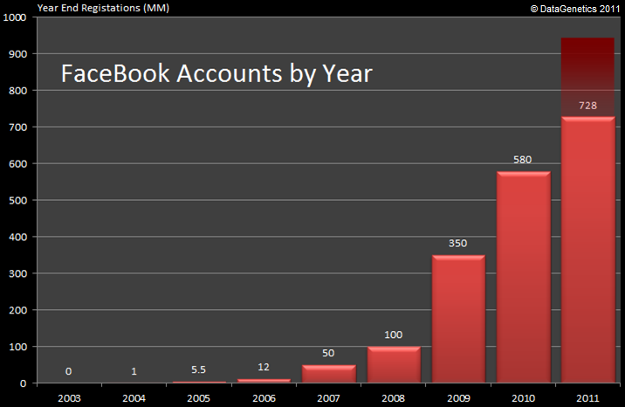

Slide 16


Just how big is FaceBook?
6.8 billion people on the planet
2.0 billion people connected to the internet
728 million registered facebook accounts
36% of the connected World already has a Facebook account!

Slide 17
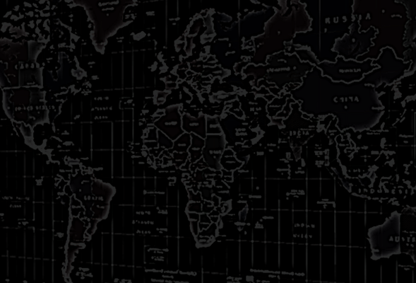
If facebook were a country …
#1 China
#2 India
#3 facebook
… it would the 3rd largest in the World.

Slide 18
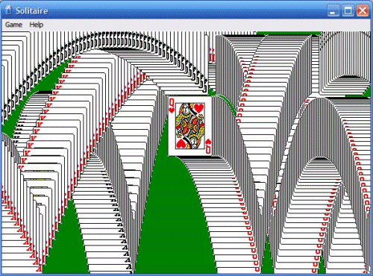
What is the most popular Windows application of all time?

Slide 19

Effect of facebook on traditional Casual Gaming web sites
Peak Population
Data courtesy of

Slide 20
Worldwide Registrations – Social Networks

Slide 21




facebook gaming is big business
“Disney Buys Playdom in $763 Million Deal, Becoming Hollywood Leader in Social Games”
“Not Playing Around. EA Buys Playfish For $300 Million, Plus a $100 Million Earnout.”
“Zynga Issues Shares at a $20 Billion Valuation”
EA Buys PopCap Games For As Much As $1.3B

Slide 22
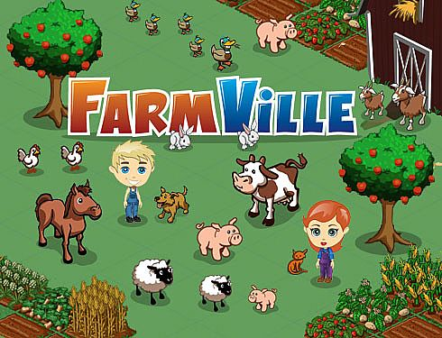
Top facebook Game
Peaked at 84 MM Monthly Active Users (MAU).
32 MM distinct people used the application at least once a day (DAU).
Close to 40% of all their users visit the application every single day!

Slide 23
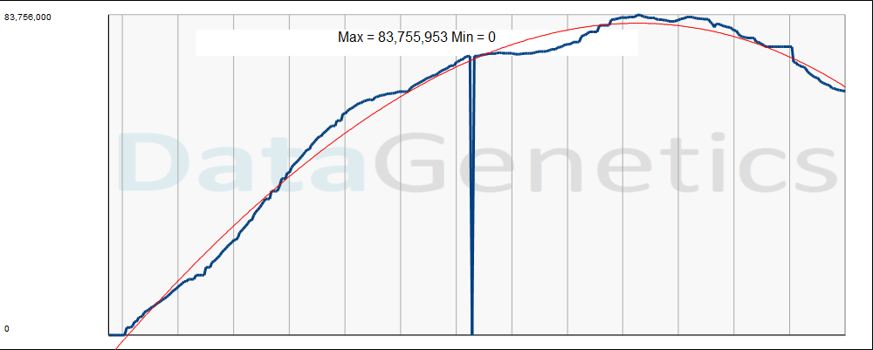
Farmville - MAU

Slide 24
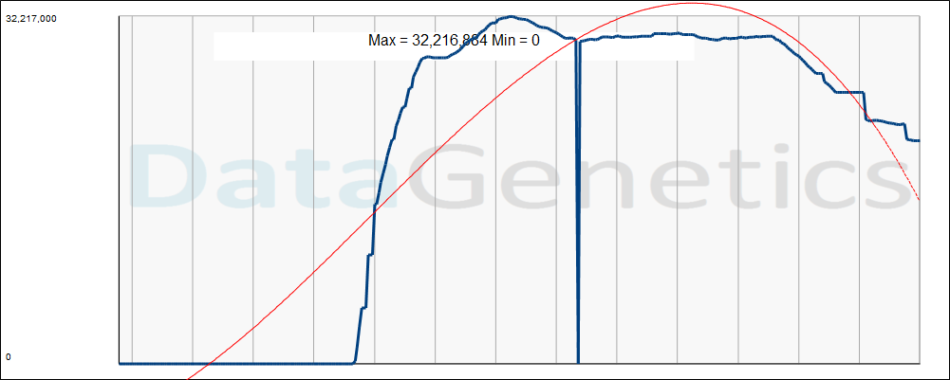
Café World - MAU

Slide 25
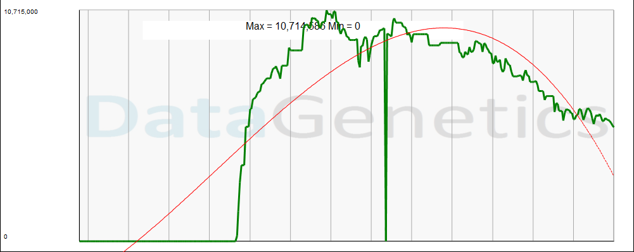
Café World - DAU

Slide 26
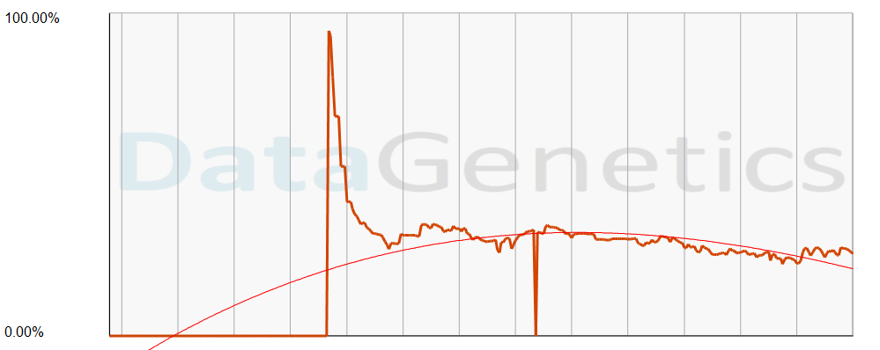
Café World - Engagement

Slide 27
facebook
Around the World

Slide 28
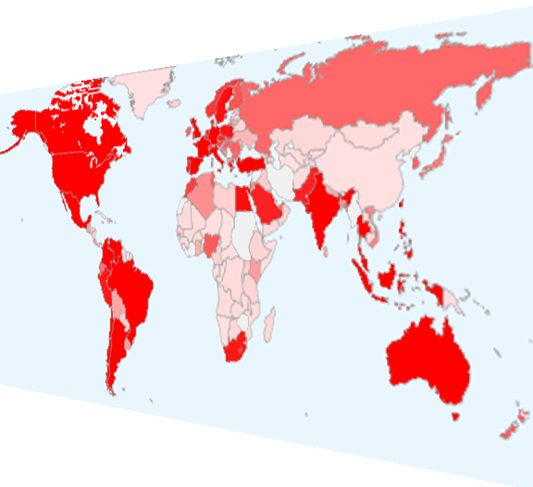

Where in the World?

Slide 29
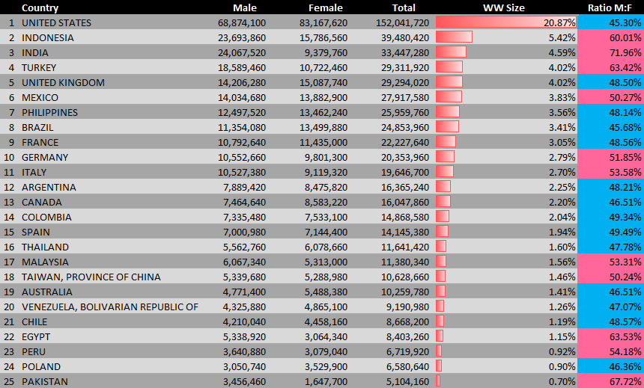
Top 25 countries on facebook
Top 30 countries account for 80% of all FaceBook registered accounts.
After Egypt, no other country accounts for more than 1%.

Slide 30
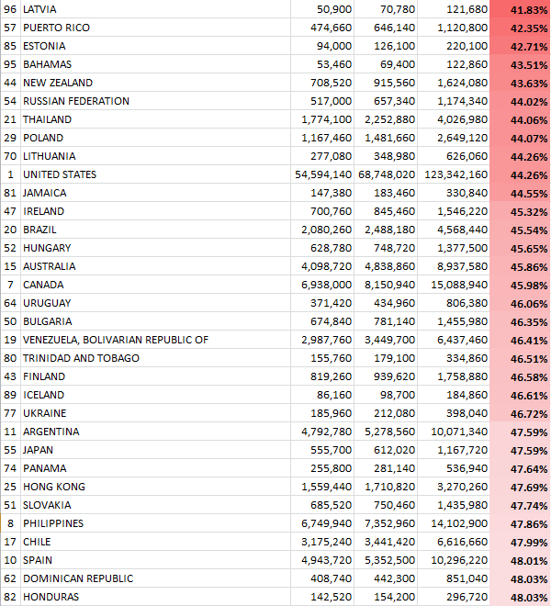
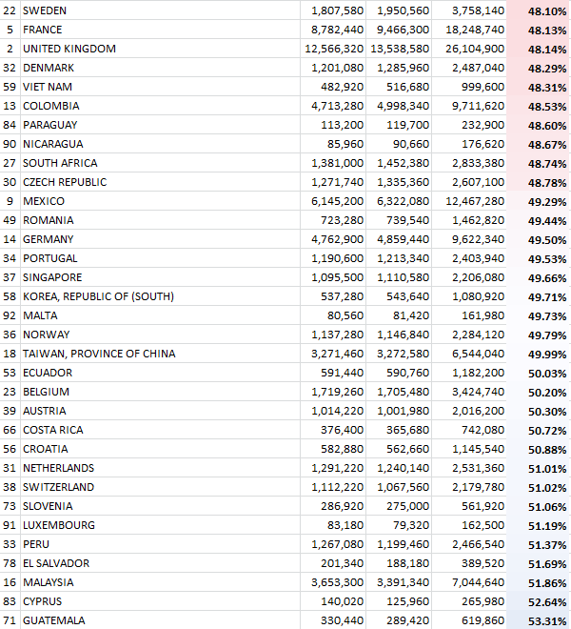
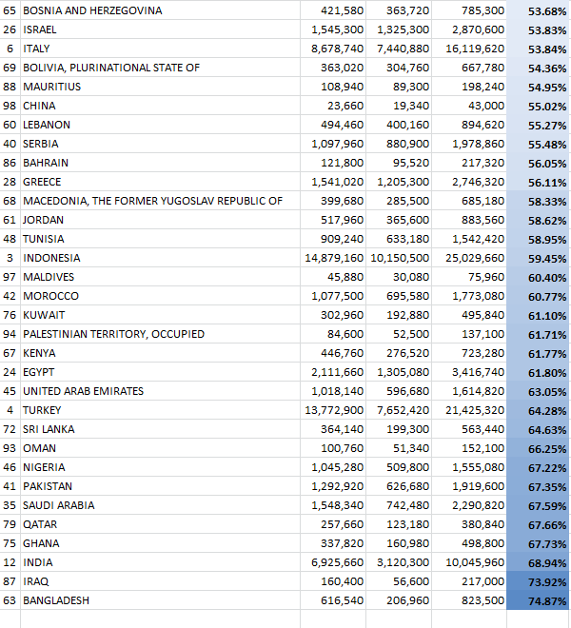
Gender breakdown of FaceBook users Worldwide
Female dominant
Male dominant
United States 44.31% male
United Kingdom 48.26% male
India 69.88 % male

Slide 31
Demographics

Slide 32
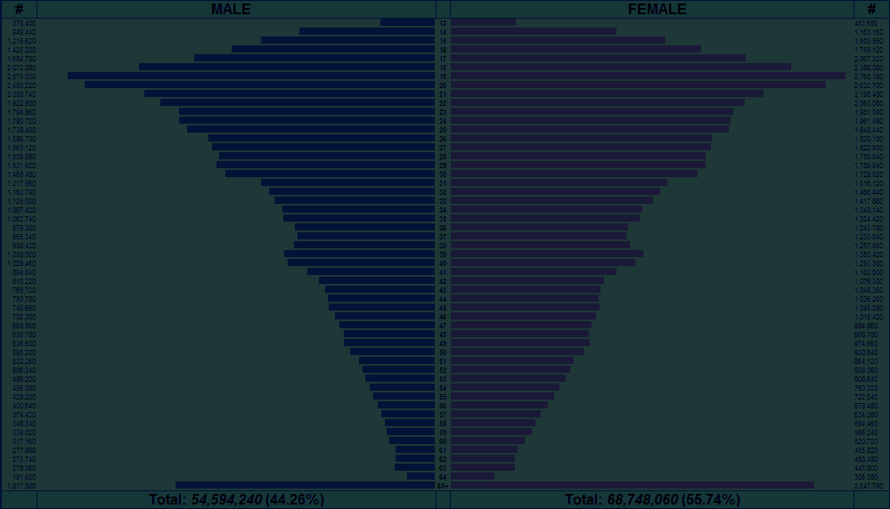
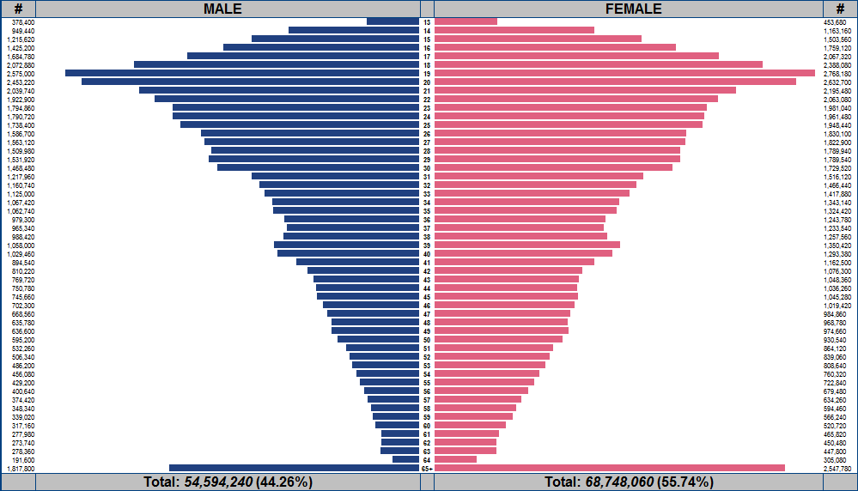
facebook Demographics
Male
13
Female
AGE
65+

Slide 33
facebook Demographics - USA
Many users of college age.
In USA large number of members over 65

Slide 34
facebook
Different Countries

Slide 35
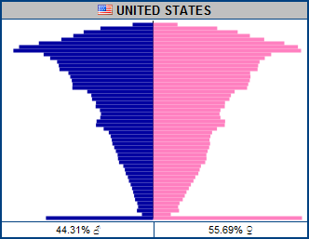
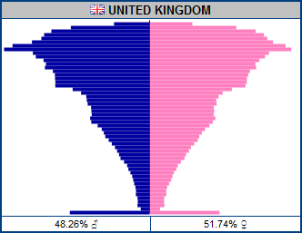
Similar Countries … Similar Profiles

Slide 36
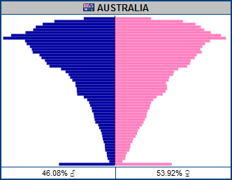
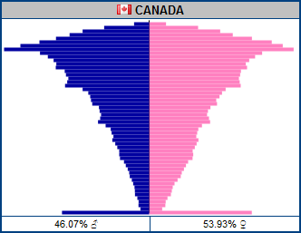
Similar Countries … Similar Profiles

Slide 37
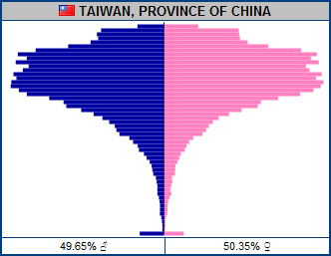
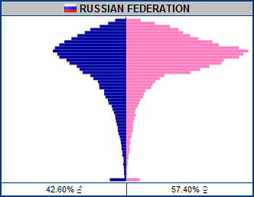
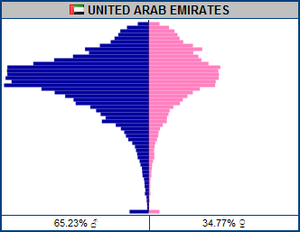
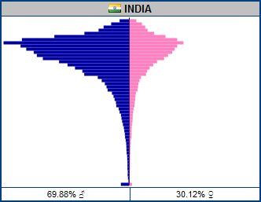
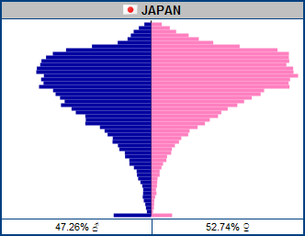
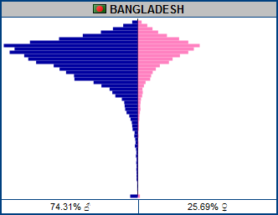
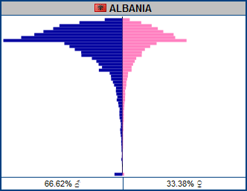
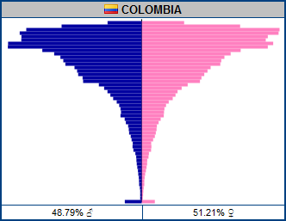
Different Countries … Different Profiles

Slide 38
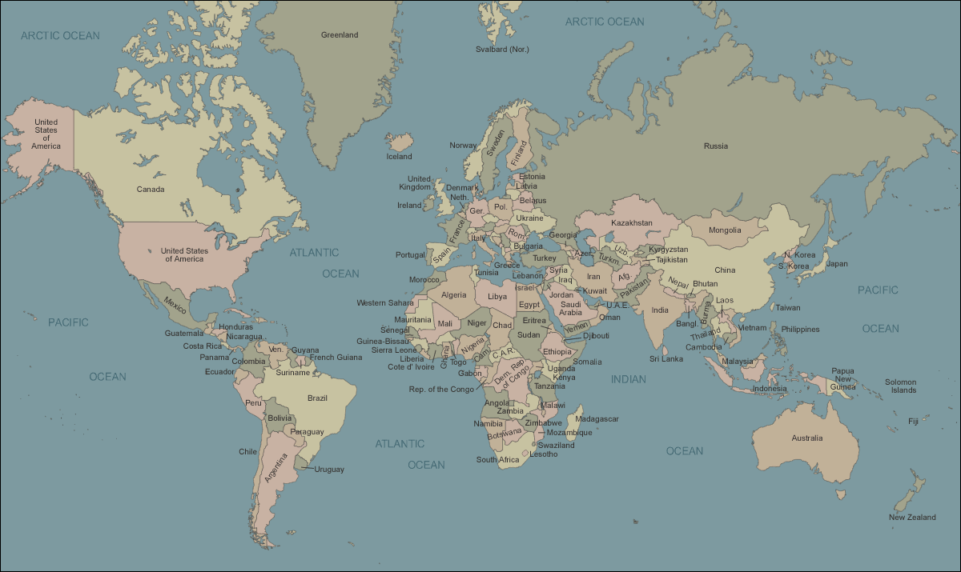
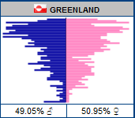
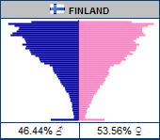
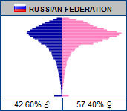
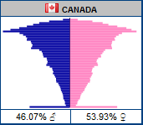
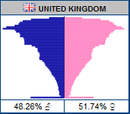
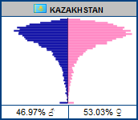
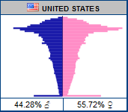
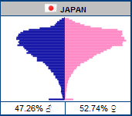
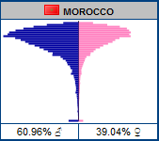
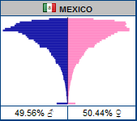
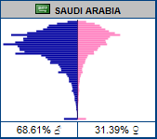
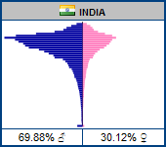
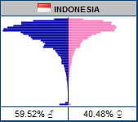
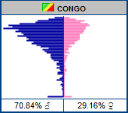







Slide 39
Interests

Slide 40

Bejeweled Blitz

Slide 41


Call of Duty 4
Tetris
Country and Rock
Fishing
Hunting
NASCAR
Black Eyed Peas
Star Trek
Star Wars
Yoville
Texas Holdem Poker
Warstorm
Happy Island
Pet Society
Fishville
Collapse!
Taylor Swift
Transformers
Country Life
Harry Potter
Britney Spears
Mobsters 2 - Vendetta
Castle Age
Vampire Wars
Twilight
Mobsters
World of Warcraft
Zoosk
Civilization
Pepsi
NFL
Converse
Jersey Shore
Victorias Secret
MTV
Coca-Cola
Pillow Fight
Sims 3
Super Mario Bros
Mafia Wars
Happy Aquarium
Cafe World
Jigsaw Puzzles
Barn Buddy
Country Story
Mythbusters
Avril Lavigne
Red Bull
Disney
Johhny Depp
Titanic
Starbucks
Red Hot Chili Peppers
Lord of the Rings
SpongeBob
McDonalds
Scrabble
(LIL) Farm Life
Dilbert
Investing
Farm Town
Law and Order
TextTwist
Farmville
Treasure Isle
Doodle Jump
Playboy
Dr Phil
Island Paradise
Zoo World
Fish World
Bejeweled Blitz
Roller Coaster Kingdom
Justin Bieber
Conan oBrien
Jay Leno
Michael Jackson
James Bond
James Patterson
Angels and Demons
Roller Coasters
Chess
Mahjong Dimensions
Mahjong
Petville
Uno
Elvis
Frank Sinatra
Soccer
Cigars
Golf
Jogging
Pilates
Yoga
Puma
Adidas
Nike
Reebok
Lifetime
Colbert
Howard Stern
Big Bang Theory
Ellen Degenerous
Dr Who
Lost
Top Gear
WWE
Wrestling
Jui Jitsu
Martial Arts
MMA
UFC
Boxing
NCIS
Cooking
Sewing
Knitting
Martha Stewart
Horses
Makeup
Fashion
Cake Decorating
Greenhouse
Bird Watching
Dogs
Plants
Cats
Flowers
Gardening
Baking
The Bachelor
Crocs
Jeep
The Office
Saturday Night Live
Scrubs
South Park
Family Guy
Simpsons
Heroes
Ugly Betty
Battlestar Galactica
Dunkin Donuts
Pizza Hut
Taco Bell
Scuba Diving
Skiing
Snowboarding
iTunes
Barry Manilow
Dairy Queen
Lady Gaga
Vin Diesel
Criminal Minds
Two and a Half Men
How I met your Mother
Medium
Ghost Whisperer
Biggest Loser
Americas Next Top Model
Sex and the City
Desperate Housewives
CSI
American Idol
Happy Pets
Mind Jolt Games
Restaurant City
Twitter
iPHONE
iPad
Pokemon
Nintendo DS
Xbox 360
PS3
Diabetes
Monopoly
Settlers of Catan
Megan Fox
Rock Band
Foursquare
Guitar Hero
Oprah Winfrey Show
Halo
Wii Fit
Wii

Slide 42





Slide 43


Jay Leno vs. Conan

Slide 44

Quiz Time – Guess the movie
Answer: Twilight™

Slide 45




Comparing Demographic “Genes”
38.41% correlation

Slide 46


Comparing Demographic “Genes”
80.89% correlation

Slide 47

Cross correlation between brands

Slide 48


Bejeweled Blitz Affinity

Slide 49


What are fans of glee on facebook interested in?

Slide 50






Slide 51

Affinity for Games

Slide 52
TV Shows

Slide 53
Music

Slide 54
Drinks, Fast Food and Footwear

Slide 55
Hobbies, Animals and Misc.

Slide 56
Micro-transactions

Slide 57

Propensity to pay?
0.8% users spend
2.1% users spend
3.0% users spend
2.6% users spend
2.4% users spend
Sorority Life, % users who spend by age
Source: “Rules to Monetize By …”, Playdom 2010

Slide 58


Are you targeting your game to the paying audience?
O
$
Even if this game had 5x the traffic, it would not generate the same revenue
Would you like to have the largest game on facebook, or the most profitable?

Slide 59

Micro-transaction types
Bling
Accelerators
Power-ups
Avatars
Fashion
Accessories
Things that do not adjust the balance of the game
Kill 10 more Orcs
= or =
Pay 10 gold coins
Pay to get 10 gold coins to get +10% attack bonus for 12 hours
+10%
Time
Money

Slide 60
The economic beauty of micro-transactions
Price
The “Tall” Tail …
$19.95
$6.95
The Long Tail …
Volume

Slide 61



Big brands are starting to get it

Slide 62

MIT research
When playing games, people are at 95-99% “focused attention”
(As measured by pupil dilation, skin resistance, pulse, movement, breathing, brain activity …)
This blows away all other media
With just 15 seconds exposure to a brand, there is >80% unaided recall.
Sponsors can receive “Halo” effect by having their brands associated with success screens and level completion events.

Slide 63

Pitching to potential Advertisers

Slide 64
Honeymoon period for brand owners with fans!
43% of fans visit facebook several times a day.
50% of fans come to facebook for entertainment.
92% say that being a fan has a positive impact in recommending to friends.
52% recommend others to follow the brand.
84% of fans consume (regularly/ocassionally) the brand.
There is no disconnect between brands followed on facebook and regular consumers.
An average of 9 brands are followed by users.
Source: DDB, October 2010

Slide 65
Closing Advice

Slide 66
You’re a Service not a Product

Slide 67

Measure Everything!
Analytics is now just as important as game design!
Play
or
Join

Slide 68

A/B Testing
It’s not just for adverts!
Use tools. Measure baseline.
Tweak, then measure again.
Denominators are large, so even minor changes can result in $$.
It’s all about the “tastes of the fish, not the tastes of the fisherman”.
Look at everything: prices, tooltips, position, offers …

Slide 69

We’re now on the second generation of Social Games
Generation #1 – Build it, and throw it live immediately.
Fix and modify it live. Those days are over!
Generation #2 – Get it mechanics reasonably polished before general release.
“You don’t get a second chance to make a first impression”
Today’s early adopters of new games:
- Virally introduce more people to your game
- Typically spend more over lifetime

Slide 70
The End
Questions?
Nick@DataGenetics.com
1010101011100110011011110110010010011001111100101001001001001001001001001001100111011011100110111101001001110011011011011011000011111001110111001100110011001110011001001011101110110110100101

